Slide 1
Capstone Project-2
NYC Taxi Trip Duration Manoj Kumar

Slide 2
Topics for discussion
Defining the Problem Statement
Data Summary
EDA
Feature Engineering
Feature Selection
Preparing Dataset for applying the model
Applying Models
Model validations

Slide 3
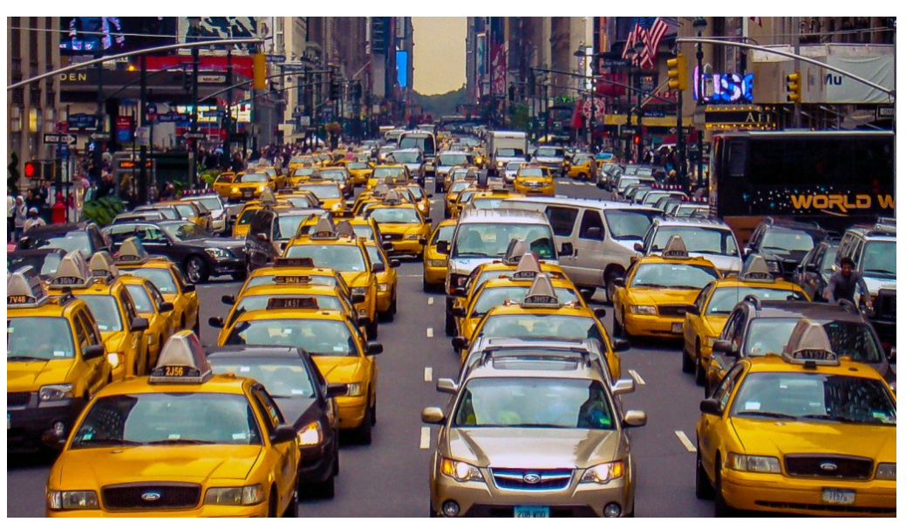
Problem Statement
A typical taxi company faces a common problem of efficiently
assigning the cabs to passengers so that the service is smooth
and hassle free. One of main issue is determining the duration
of the current trip so it can predict when the cab will
be free for the next trip.
The data set contains the data regarding several taxi trips and its duration in New York City. I will now try and apply different techniques of Data Analysis to get insights about the data and determine how different variables are dependent on the target variable Trip Duration.

Slide 4
Data Pipeline
Data Preprocessing:- NYC Taxi Trip data contains outliers and we have removed the outliers in the first step. Then converting the categorical/object datatype variables to numerical representation and selecting features from numerical data which makes easier for the model to learn.
EDA:- We did some Exploratory Data Analysis on the data to Analyze most of the information.
Model Creation: Once we have analyzed the data, next will be building the model to predict the taxi trip duration. We will start from the simple model and apply different regression models to predict the same.

Slide 5
Data Summary
Df_taxi:- This variable holds all the original data such as id,Vendor_id, pickup_datetime, dropoff_datetime, trip_duration,passenger counts , pickup longitude , pickup latitude,dropoff longitude , dropoff latitude and so on.
This dataset holds 1.4+ Millions of rows

Slide 6
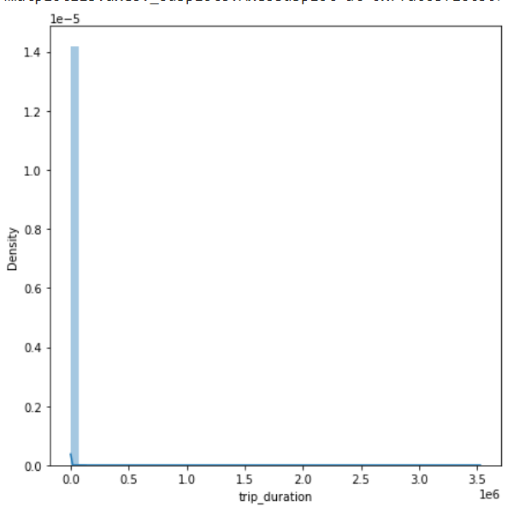
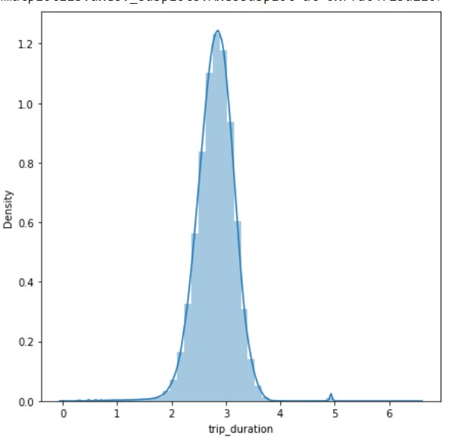
EDA- Univariate
Before Applying Log10
After Applying Log10

Slide 7
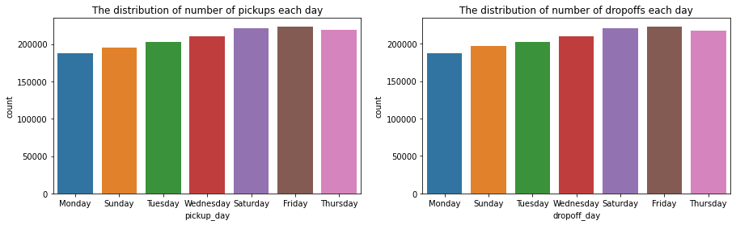
DISTRIBUTION OF PICKUPS
a
We can see most trips were taken on Friday & least trips were taken on Monday.

Slide 8
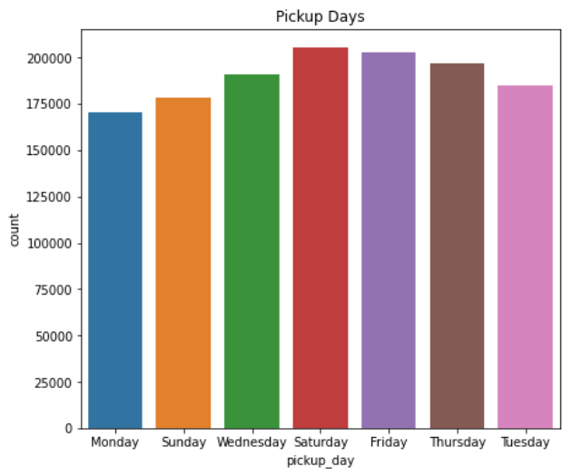
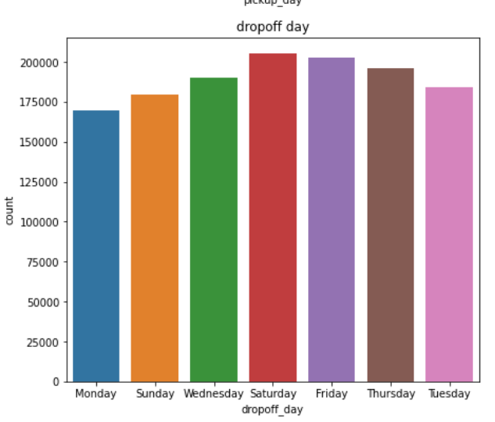
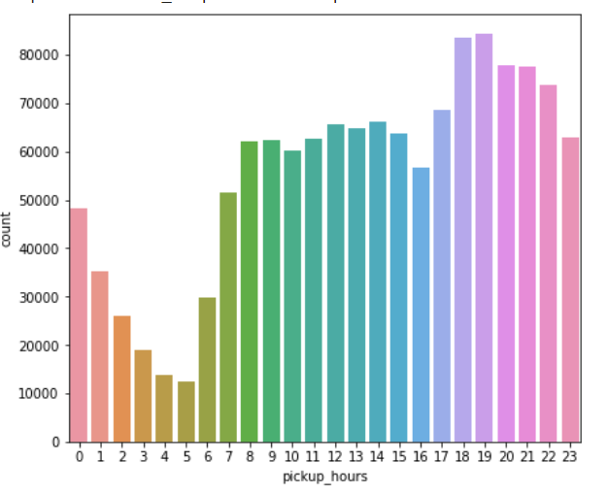
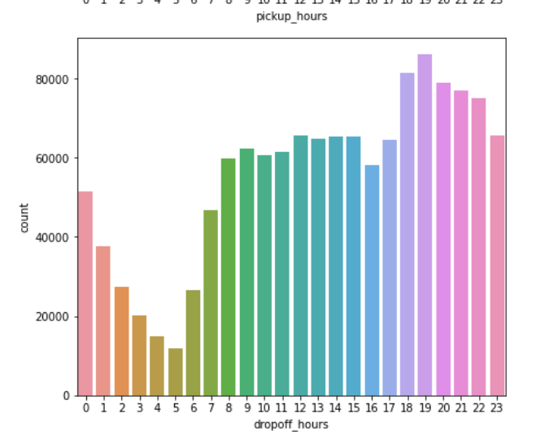
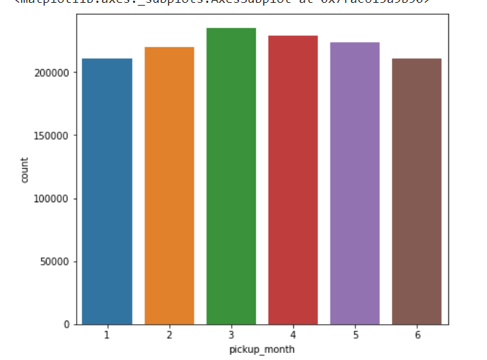
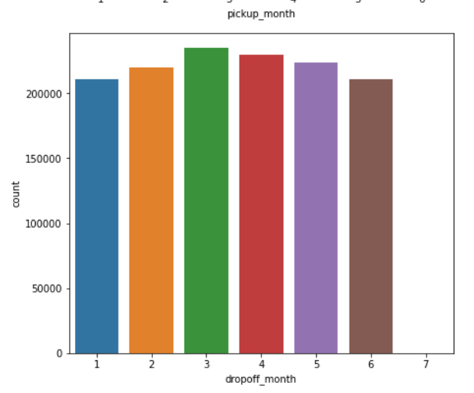
DISTRIBUTION OF ALL THE INDEPENDENT VARIABLES

Slide 9
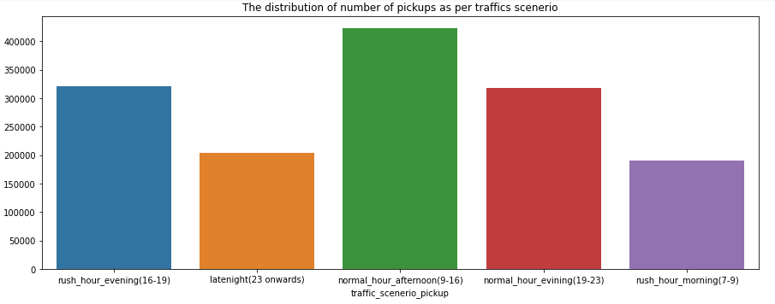
TRAFFIC SCENARIO(PICKUPS)

Slide 10
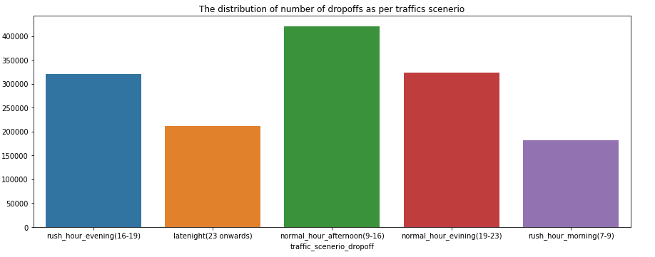
TRAFFIC SCENARIO(DROPOFF)

Slide 11
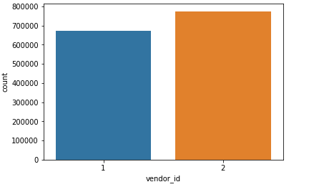
DISTRIBUTION OF VENDOR ID

Slide 12
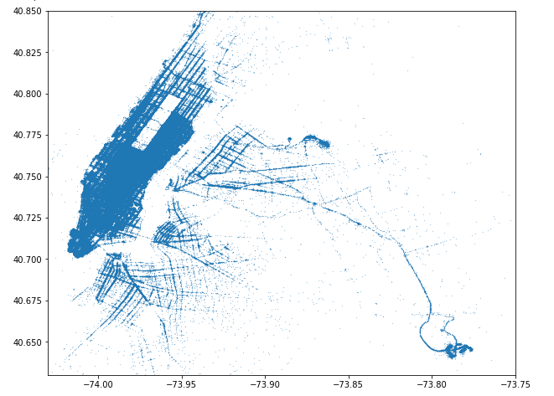

Slide 13
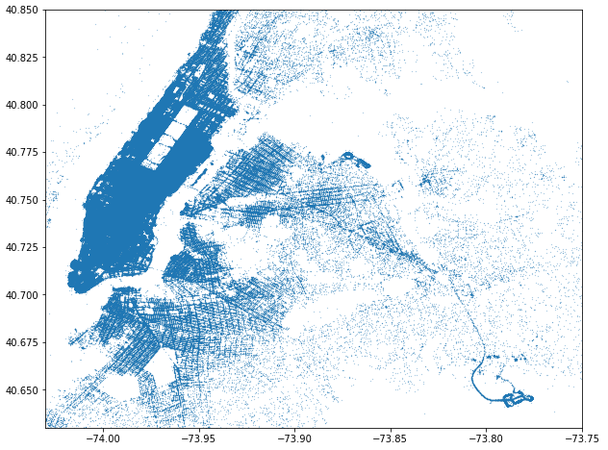

Slide 14
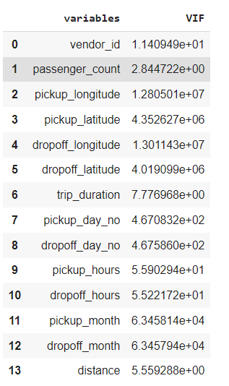
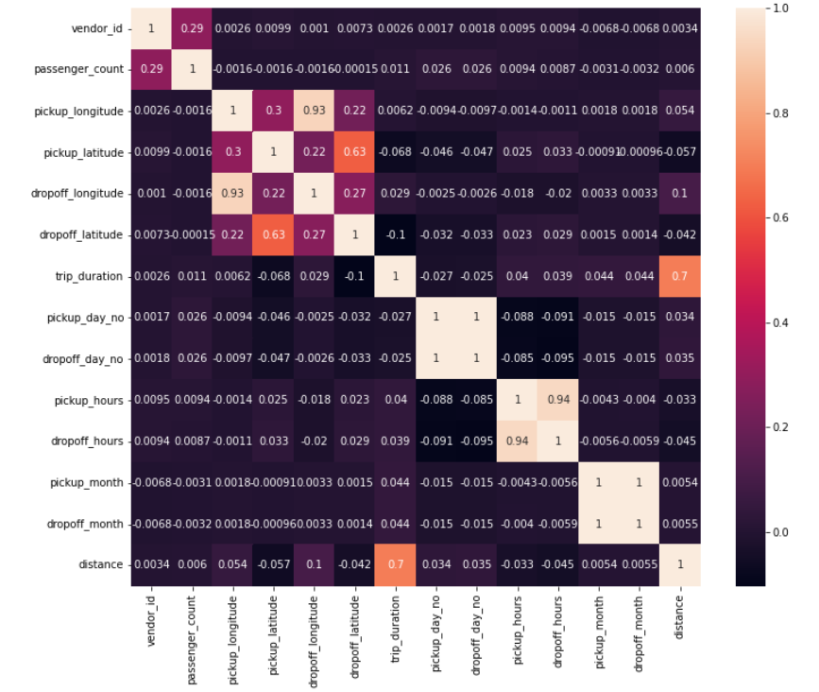
Correlations and VIF

Slide 15
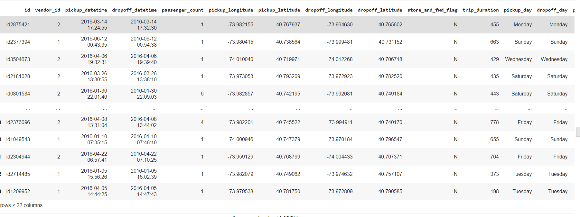

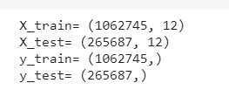
Training and Testing

Slide 16

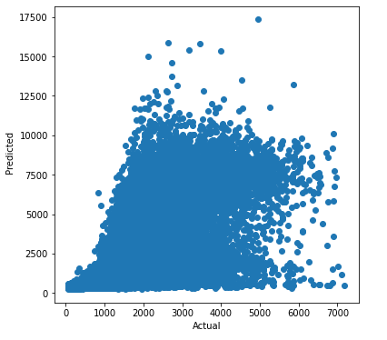

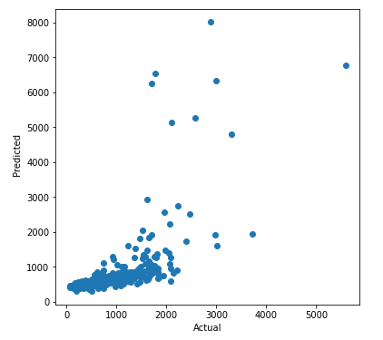
Linear Regression Model and Validation

Slide 17

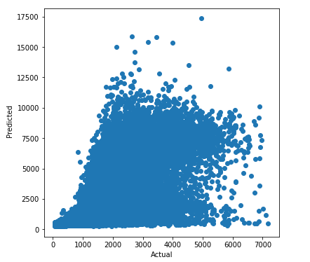

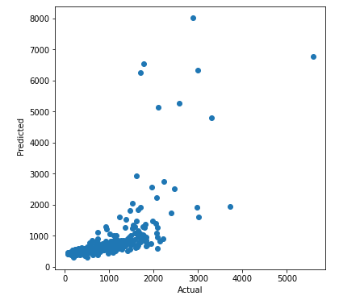
Ridge Regression With Validation

Slide 18

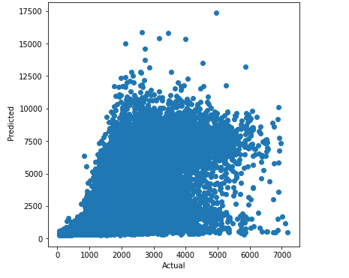

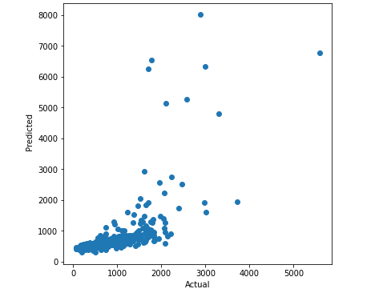
Lasso Regression and validation

Slide 19
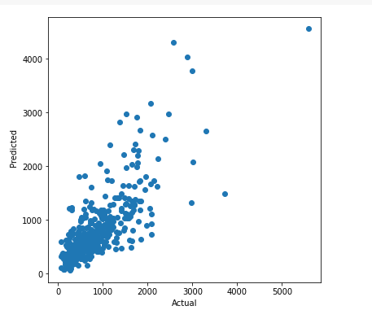
DECISION TREE REGRESSOR
r
RMSE SCORE = 452.84
R2 SCORE = 0.47665
TRAIN SCORE = 0.9095794
TEST SCORE = 0.4975

Slide 20
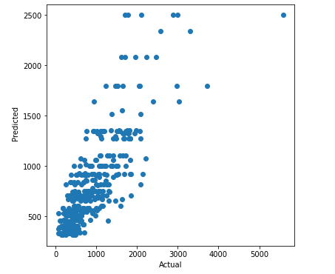
ADABOOST REGRESSION
R

Slide 21
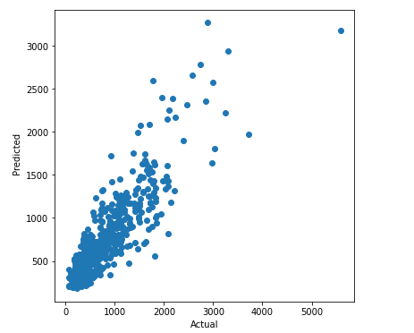
XGBoost Regressor and validation

Slide 22
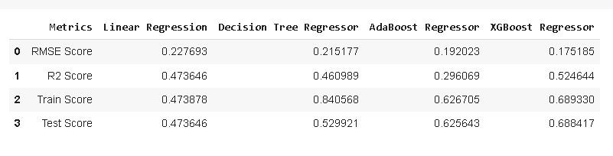
* Model Performance Assessment*

Slide 23
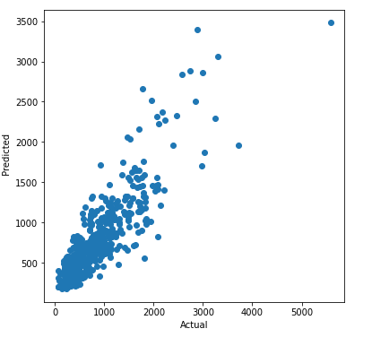



PARAMETER TUNING

Slide 24
Conclusion
We got 1.4 million+ of data which contains outliers, we have removed the outliers and applied training for 1 Million on training and 25k for training to predict the trip duration
From the EDA, the pickup and drop-off of the trip is peak at 9AM-7PM and most of the trips are taken on FRIDAYS and SATURADAYS and least on MONDAYS
We applied Linear regression model to our training and testing data, where the R2 score result is 47% which is not good for predicting and it doesn’t show any sign of homoscedasticity.
We applied Ridge regression with lambda=0.01 and the model does not give the expected result
Next, we applied Lasso regression with lambda=0.005 with maximum iteration of 3000 which yield unaccepted result
Then we applied Decision tree regression model and got only 47% r2 score
we applied ADAboost Regressor and this model gives 18% of R2 score, which is not acceptable at all
Then we applied XGboost regression model and it gave us tremendous result of r2 score of 52% . So we need to apply hyperparameter tuning in this model to get a better result
After finding the best fit parameters , we applied the parameters in the regression model and got a modified model which has an excellent score of 54% approximately.

